Slide 1

Inversion of Control

Slide 2
Inversion of Control (IoC)
The approach of outsourcing the
construction and management of objects.

Slide 3



Coding Scenario
getDailyWorkout()
My App
CricketCoach
•
App should be configurable
•
Easily change the coach for another sport
•
Baseball, Hockey, Tennis, Gymnastics etc …

Slide 4




Ideal Solution
Object Factory
give me a “Coach” object
My App
configuration
CricketCoach
BaseballCoach
HockeyCoach

Slide 5


Spring Container
Spring
Object Factory
give me a “Coach” object
My App
configuration
CricketCoach
BaseballCoach
HockeyCoach

Slide 6
Spring Container
Spring
•
Primary functions
Object Factory
•
Create and manage objects (Inversion of Control)
•
Inject object dependencies (Dependency Injection)

Slide 7
Configuring Spring Container
•
XML configuration file (legacy)
•
Java Annotations (modern)
•
Java Source Code (modern)

Slide 8
Spring Dependency Injection

Slide 9
Dependency Injection
The dependency inversion principle.
The client delegates to another object the responsibility of providing its dependencies.

Slide 10






Car Factory
give me a “Car” object
Car Factory

Slide 11


Spring Container
Spring Object Factory
give me a “Coach” object
My App
configuration
dependencies (helper objects)
CricketCoach
HockeyCoach
BaseballCoach
dependencies (helper objects)
dependencies (helper objects)

Slide 12
Spring Container
Spring
•
Primary functions
Object Factory
•
Create and manage objects (Inversion of Control)
•
Inject object’s dependencies (Dependency Injection)

Slide 13

Demo Example
•
Coach will provide daily workouts
•
The DemoController wants to use a Coach
•
New helper: Coach
DemoController
•
This is a dependency
Coach
•
Need to inject this dependency

Slide 14
Injection Types
•
There are multiple types of injection with Spring
•
We will cover the two recommended types of injection
•
Constructor Injection
•
Setter Injection

Slide 15
Injection Types - Which one to use?
•
Constructor Injection
•
Use this when you have required dependencies
•
Generally recommended by the spring.io development team as first choice
•
Setter Injection
•
Use this when you have optional dependencies
•
If dependency is not provided, your app can provide reasonable default logic

Slide 16

What is Spring AutoWiring
DemoController
Coach
•
For dependency injection, Spring can use autowiring
•
Spring will look for a class that matches
•
matches by type: class or interface
•
Spring will inject it automatically … hence it is autowired

Slide 17
Autowiring Example
DemoController
Coach
•
Injecting a Coach implementation
•
Spring will scan for @Components
•
Any one implements the Coach interface???
•
If so, let’s inject them. For example: CricketCoach

Slide 18
Example Application
/dailyworkout
getDailyWorkout()
Web Browser
DemoController
Coach
“Practice fast bowling for 15 minutes”
“Practice fast bowling for 15 minutes”

Slide 19
Development Process - Constructor Injection
Define the dependency interface and class
Create Demo REST Controller
Create a constructor in your class for injections
Add @GetMapping for /dailyworkout
Step-By-Step

Slide 20


Step 1: Define the dependency interface and class
File: Coach.java
package com.luv2code.springcoredemo;
public interface Coach {
File: CricketCoach.java
package com.luv2code.springcoredemo;
import org.springframework.stereotype.Component; @Component
public class CricketCoach implements Coach {
@Override
public String getDailyWorkout() {
return "Practice fast bowling for 15 minutes";
String getDailyWorkout();
}
@Component annotation marks the class
as a Spring Bean
}
}

Slide 21
@Component annotation
@Component marks the class as a Spring Bean
A Spring Bean is just a regular Java class that is managed by Spring
•
@Component also makes the bean available for dependency injection

Slide 22

Step 2: Create Demo REST Controller
File: DemoController.java
package com.luv2code.springcoredemo;
import org.springframework.web.bind.annotation.RestController; @RestController
public class DemoController {
}

Slide 23





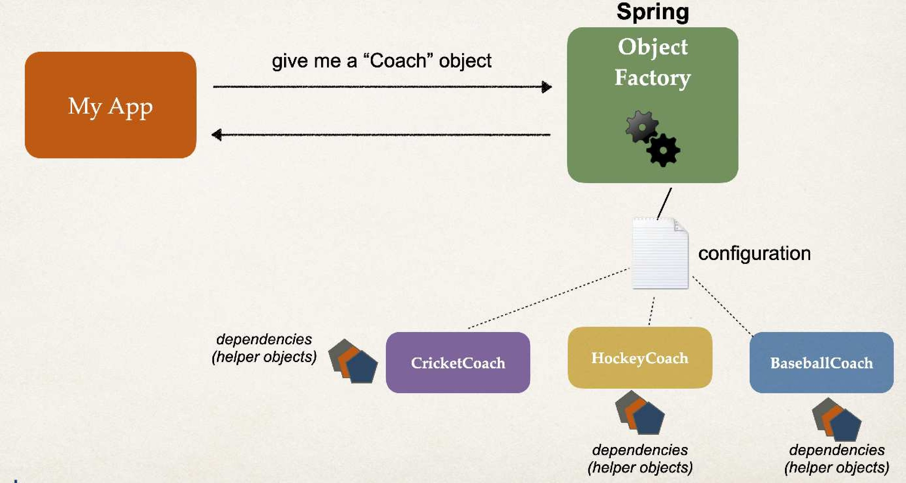
Step 3: Create a constructor in your class for injections
File: DemoController.java
package com.luv2code.springcoredemo;
If you only have one constructor then @Autowired on constructor is optional
import org.springframework.beans.factory.annotation.Autowired; import org.springframework.web.bind.annotation.RestController;
@RestController
public class DemoController {
@Autowired annotation tells Spring to inject a dependency
private Coach myCoach;
@Autowired
public DemoController(Coach theCoach) { myCoach = theCoach;
}
}
At the moment, we only have one Coach implementation CricketCoach.
Spring can figure this out.
Later in the course we will cover
the case of multiple Coach implementations.

Slide 24


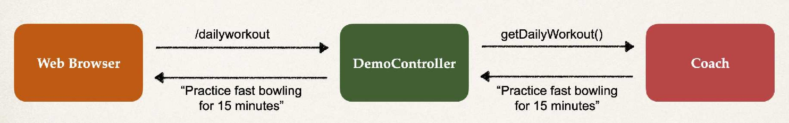
Step 4: Add @GetMapping for /dailyworkout
File: DemoController.java
package com.luv2code.springcoredemo;
import import import
org.springframework.beans.factory.annotation.Autowired; org.springframework.web.bind.annotation.GetMapping; org.springframework.web.bind.annotation.RestController;
@RestController
public class DemoController {
private Coach myCoach; @Autowired
public DemoController(Coach theCoach) { myCoach = theCoach;
}
@GetMapping("/dailyworkout") public String getDailyWorkout() {
return myCoach.getDailyWorkout();
}
}

Slide 25
Constructor Injection Behind the Scenes

Slide 26



How Spring Processes your application
File: Coach.java
File: CricketCoach.java
package com.luv2code.springcoredemo;
…
File: DemoController.java
package com.luv2code.springcoredemo;
package com.luv2code.springcoredemo;
…
public interface Coach {
@Component
public class CricketCoach implements Coach {
@Override
public String getDailyWorkout() { return "Practice fast bowling for 15
}
@RestController
public class DemoController {
String getDailyWorkout();
}
private Coach myCoach;
minutes";
@Autowired
public DemoController(Coach theCoach) { myCoach = theCoach;
}
…
}
}

Slide 27


The Spring Framework will perform operations
behind the scenes for you :-)

Slide 28

How Spring Processes your application
File: Coach.java
File: CricketCoach.java
package com.luv2code.springcoredemo;
…
File: DemoController.java
package com.luv2code.springcoredemo;
package com.luv2code.springcoredemo;
…
public interface Coach {
@Component
public class CricketCoach implements Coach {
@RestController
public class DemoController {
String getDailyWorkout();
}
@Override
public String getDailyWorkout() { return "Practice fast bowling
}
private Coach myCoach;
for 15 minutes";
@Autowired
public DemoController(Coach myCoach = theCoach;
}
…
theCoach) {
}
}
Spring Framework
Coach theCoach = new CricketCoach();
Constructor injection
DemoController demoController = new DemoController(theCoach);

Slide 29
The “new” keyword … is that it???
You may wonder …
Is it just the “new” keyword???
I don’t need Spring for this … I can do this by myself LOL!!!
•
Spring is more than just Inversion of Control and Dependency Injection
•
For small basic apps, it may be hard to see the benefits of Spring

Slide 30

Spring for Enterprise applications
Spring is targeted for enterprise, real-time / real-world applications
Spring provides features such as
Database access and Transactions
REST APIs and Web MVC
Security
etc …
Later in the course,
we will build a real-time CRUD REST API with database access.
You will see the Spring features in action.
Good things are coming :-)

Slide 31
Component Scanning
© luv2code LLC

Slide 32
Scanning for Component Classes
•
Spring will scan your Java classes for special annotations
•
@Component, etc …
•
Automatically register the beans in the Spring container

Slide 33


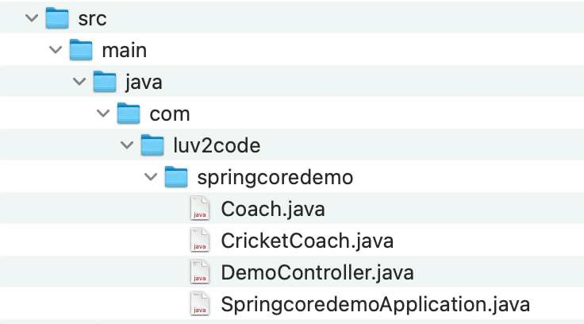

Java Source Code
RestController that we created in an earlier video
Main Spring Boot application class
Created by Spring Initializr

Slide 34
Java Source Code
File: SpringcoredemoApplication.java
package com.luv2code.springcoredemo;
import import
org.springframework.boot.SpringApplication; org.springframework.boot.autoconfigure.SpringBootApplication;
@SpringBootApplication
public class SpringcoredemoApplication {
public static void main(String[] args) {
SpringApplication.run(SpringcoredemoApplication,
args);
}
}

Slide 35

Java Source Code
File: SpringcoredemoApplication.java
package com.luv2code.springcoredemo;
import import
org.springframework.boot.SpringApplication; org.springframework.boot.autoconfigure.SpringBootApplication;
@SpringBootApplication
public class SpringcoredemoApplication {
Enables
public static void main(String[] args)
SpringApplication.run(Springcoredemo_{C}Ap_{o}p_{m}li_{p}ca_{o}t_{n}i_{e}on_{n},_{t s}ar_{c}g_{a}s_{n});_{ning}
Additional configuration
{Auto configuration
}
}

Slide 36

Java Source Code
File: SpringcoredemoApplication.java
package com.luv2code.springcoredemo;
import import
org.springframework.boot.SpringApplication; org.springframework.boot.autoconfigure.SpringBootApplication;
@SpringBootApplication
public class
SpringcoredemoAppliCcaotmiopno{sed of following annotations
public static void main(String[]
SpringApplication.run(SpringcoredemoAp@pl_{C}ic_{o}a_{m}ti_{p}o_{o}n,_{ne}a_{n}rg_{tS}s)_{c};_{an}
@Configuration
^{ar}@^{gs}E⁾n{ableAutoConfiguration
}
}

Slide 37





Annotations
•
@SpringBootApplication is composed of the following annotations:
Annotation | Description
@EnableAutoConfiguration | Enables Spring Boot's auto-configuration support
@ComponentScan | Enables component scanning of current package Also recursively scans sub-packages
@Configuration | Able to register extra beans with @Bean or import other configuration classes

Slide 38


Java Source Code
File: SpringcoredemoApplication.java
package com.luv2code.springcoredemo;
import import
org.springframework.boot.SpringApplication; org.springframework.boot.autoconfigure.SpringBootApplication;
@SpringBootApplication
public class SpringcoredemoApplication {
public static void main(String[] args) {
SpringApplication.run(SpringcoredemoApplication,
args);
}
}
Bootstrap your Spring Boot application

Slide 39



Java Source Code
Behind the scenes …
File: SpringcoredemoApplication.java
package com.luv2code.springcoredemo;
Creates application context
import import
org.springframework.boot.SpringApplication; and registers all beans
org.springframework.boot.autoconfigure.SpringBootApplication;
Starts the embedded server
@SpringBootApplication
public class SpringcoredemoApplication {
Tomcat etc…
public static void main(String[] args) {
SpringApplication.run(SpringcoredemoApplication,
args);
}
}
Bootstrap your Spring Boot application

Slide 40
More on Component Scanning
•
By default, Spring Boot starts component scanning
•
From same package as your main Spring Boot application
•
Also scans sub-packages recursively
•
This implicitly defines a base search package
•
Allows you to leverage default component scanning
•
No need to explicitly reference the base package name

Slide 41


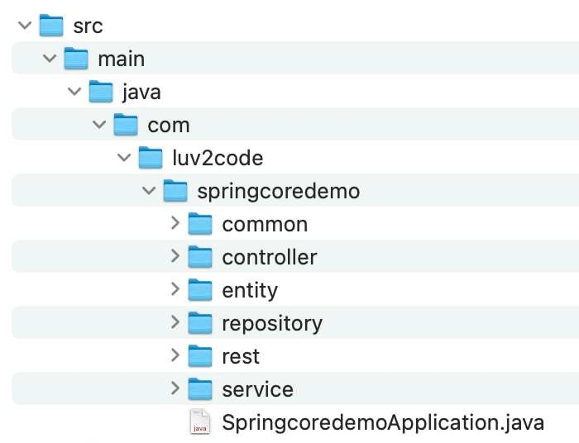


More on Component Scanning
Scans everything in com.luv2code.springcoredemo
And any sub-packages (recursively)
Any other sub-packages you create Can give them any name
Main Spring Boot application class
Automatically component scans package and sub-packages

Slide 42


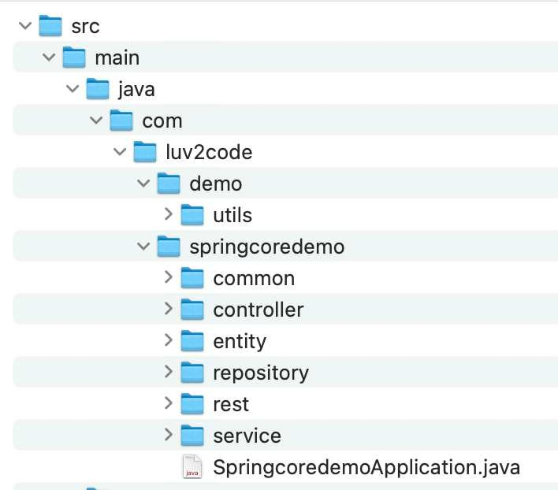


Common Pitfall - Different location
By default, Spring Boot will not component scan these packages
Only package of main Spring Boot application class
and sub-packages
1
Main Spring Boot application class
Automatically component scans package and sub-packages

Slide 43


More on Component Scanning
Default scanning is fine if everything is under
com.luv2code.springcoredemo
Explicitly list base packages to scan
•
But what about my other packages?
com.luv2code.util
org.acme.cart edu.cmu.srs
•
package com.luv2code.springcoredemo;
… @SpringBootApplication(
scanBasePackages={"com.luv2code.springcoredemo",
"com.luv2code.util", "org.acme.cart",
"edu.cmu.srs"})
•
public class SpringcoredemoApplication {
…
}

Slide 44
Setter Injection

Slide 45
Spring Injection Types
Constructor Injection
•
Setter Injection

Slide 46
Inject dependencies by calling
setter method(s) on your class

Slide 47
Autowiring Example
DemoController
Coach
•
Injecting a Coach implementation
•
Spring will scan for @Components
•
Any one implements the Coach interface???
•
If so, let’s inject them. For example: CricketCoach

Slide 48
Development Process - Setter Injection
Step-By-Step
Create setter method(s) in your class for injections
Configure the dependency injection with @Autowired Annotation

Slide 49

Step1: Create setter method(s) in your class for injections
File: DemoController.java
@RestController
public class DemoController {
private Coach myCoach;
public void setCoach(Coach theCoach) { myCoach = theCoach;
}
…
}
www.luv2code.com

Slide 50

Step 2: Configure the dependency injection with Autowired Annotation
File: DemoController.java
@RestController
public class DemoController {
private Coach myCoach;
@Autowired public void
myCoach
setCoach(Coach theCoach) {
= theCoach;
}
…
}

Slide 51
The Spring Framework will perform operations
behind the scenes for you :-)

Slide 52






How Spring Processes your application
File: Coach.java
File: CricketCoach.java
File: DemoController.java
public interface Coach {
@Component
public class CricketCoach implements
@Override
public String getDailyWorkout() { return "Practice fast bowling
@RestController
public class DemoController {
Coach {
String getDailyWorkout();
private Coach myCoach;
}
for 15 minutes";
@Autowired
public void setCoach(Coach myCoach = theCoach;
}
…
}
theCoach) {
}
}
Spring Framework
Setter injection
Coach theCoach = new CricketCoach();
DemoController demoController = new DemoController();
demoController.setCoach(theCoach);

Slide 53
Inject dependencies by calling
ANY method on your class Simply give: @Autowired

Slide 54

Step 2: Configure the dependency injection with Autowired Annotation
File: DemoController.java
@RestController
public class DemoController {
private Coach myCoach;
Can use any method name
@Autowired public void
myCoach
doSomeStuff(Coach theCoach) {
= theCoach;
}
…
}

Slide 55
Injection Types - Which one to use?
•
Constructor Injection
•
Use this when you have required dependencies
•
Generally recommended by the spring.io development team as first choice
•
Setter Injection
•
Use this when you have optional dependencies
•
If dependency is not provided, your app can provide reasonable default logic

Slide 56
Field Injection with Annotations and Autowiring

Slide 57
Spring Injection Types
•
Recommended by the spring.io development team
Constructor Injection: required dependencies
Setter Injection: optional dependencies
•
Not recommended by the spring.io development team
Field Injection

Slide 58
Field Injection … no longer cool
•
In the early days, field injection was popular on Spring projects
In recent years, it has fallen out of favor
•
In general, it makes the code harder to unit test
•
As a result, the spring.io team does not recommend field injection
However, you will still see it being used on legacy projects

Slide 59


Inject dependencies by setting field values on your class directly
(even private fields)
Accomplished by using Java Reflection

Slide 60



Step 1: Configure the dependency injection with Autowired Annotation
File: DemoController.java
package com.luv2code.springcoredemo;
import org.springframework.beans.factory.annotation.Autowired;
…
@RestController
public class DemoController {
@Autowired
private Coach myCoach;
Field injection
// no need for constructors or setters
@GetMapping("/dailyworkout") public String getDailyWorkout() {
return myCoach.getDailyWorkout();
}
Field injection is not recommended by
}
spring.io development team.
Makes the code harder to unit test.

Slide 61
Annotation Autowiring and Qualifiers

Slide 62
Autowiring
DemoController
Coach
•
Injecting a Coach implementation
•
Spring will scan @Components
•
Any one implements Coach interface???
•
If so, let’s inject them … oops which one?

Slide 63
Multiple Coach Implementations
Coach
CricketCoach
TennisCoach
BaseballCoach
TrackCoach

Slide 64



Multiple Coach Implementations
package com.luv2code.springcoredemo.common;
package com.luv2code.springcoredemo.common;
import org.springframework.stereotype.Component;
import org.springframework.stereotype.Component;
@Component
public class CricketCoach implements Coach {
@Component
public class BaseballCoach implements Coach {
@Override
public String getDailyWorkout() { return "Practice fast bowling
@Override
public String getDailyWorkout() {
return "Spend 30 minutes in batting practice";
}
for 15 minutes";
}
}
}
package com.luv2code.springcoredemo.common;
import org.springframework.stereotype.Component;
package com.luv2code.springcoredemo.common;
import org.springframework.stereotype.Component;
@Component
public class TrackCoach implements Coach {
@Component
public class TennisCoach implements Coach {
@Override
public String getDailyWorkout() { return "Run a hard 5k!";
@Override
public String getDailyWorkout() {
return "Practice your backhand volley";
}
}
}
}

Slide 65
Umm, we have a little problem ….
Parameter 0 of constructor in com.luv2code.springcoredemo.rest.DemoController required a single bean, but 4 were found:
baseballCoach
cricketCoach
tennisCoach
trackCoach
…

Slide 66



Solution: Be specific! - @Qualifier
package com.luv2code.springcoredemo.rest;
import import import
…
com.luv2code.springcoredemo.common.Coach; org.springframework.beans.factory.annotation.Autowired; org.springframework.beans.factory.annotation.Qualifier;
Specify the bean id: cricketCoach
@RestController
public class DemoController {
Same name as class, first character lower-case
private Coach myCoach;
@Autowired
public DemoController(@Qualifier("cricketCoach") myCoach = theCoach;
}
Coach theCoach) {
@GetMapping("/dailyworkout") public String getDailyWorkout() {
return myCoach.getDailyWorkout();
}
Other bean ids we could use:
baseballCoach, trackCoach, tennisCoach
}

Slide 67
For Setter Injection
If you are using Setter injection, can also apply @Qualifier annotation

Slide 68
Setter Injection - @Qualifier
package com.luv2code.springcoredemo.rest;
import import import
…
com.luv2code.springcoredemo.common.Coach; org.springframework.beans.factory.annotation.Autowired; org.springframework.beans.factory.annotation.Qualifier;
Give bean id: cricketCoach
@RestController
public class DemoController {
Same name as class, first character lower-case
private Coach myCoach;
@Autowired
public void setCoach(@Qualifier("cricketCoach") myCoach = theCoach;
}
Coach theCoach) {
@GetMapping("/dailyworkout") public String getDailyWorkout() {
return myCoach.getDailyWorkout();
}
Other bean ids we could use:
baseballCoach, trackCoach, tennisCoach
}

Slide 69
@Primary annotation

Slide 70

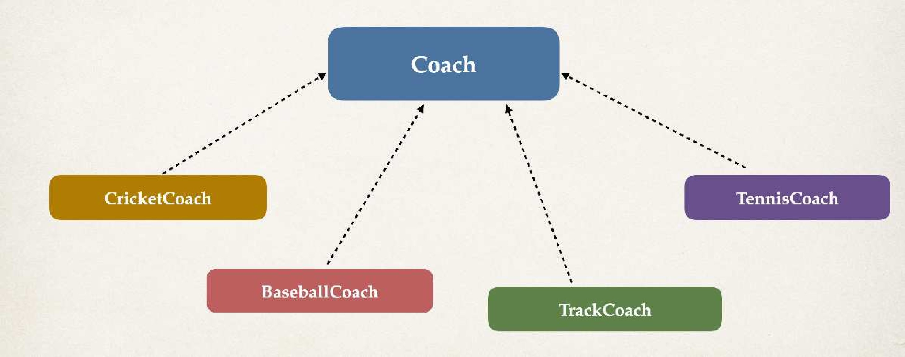
Resolving issue with Multiple Coach implementations
•
In the case of multiple Coach implementations
•
We resolved it using @Qualifier
•
We specified a coach by name
•
Alternate solution available …

Slide 71

Alternate solution
•
Instead of specifying a coach by name using @Qualifier
•
I simply need a coach … I don’t care which coach
•
If there are multiple coaches
•
Then you coaches figure it out … and tell me who’s the primary coach

Slide 72


Multiple Coach Implementations
package com.luv2code.springcoredemo.common;
@Component public class
…
}
BaseballCoach implements Coach {
import org.springframework.context.annotation.Primary; import org.springframework.stereotype.Component;
@Component @Primary
public class TrackCoach implements Coach {
@Component public class
…
}
@Override
public String getDailyWorkout() { return "Run a hard 5k!";
}
TennisCoach implements Coach {
}
@Component public class
…
}
CricketCoach implements Coach {

Slide 73



Resolved with @Primary
package com.luv2code.springcoredemo.rest;
import com.luv2code.springcoredemo.common.Coach;
import org.springframework.beans.factory.annotation.Autowired;
…
No need for @Qualifier
@RestController
public class DemoController {
There is a @Primary coach This example will use TrackCoach
private Coach myCoach;
@Autowired
public DemoController(Coach myCoach = theCoach;
}
theCoach) {
package com.luv2code.springcoredemo.common;
import org.springframework.context.annotation.Primary; import org.springframework.stereotype.Component;
@GetMapping("/dailyworkout") public String getDailyWorkout() {
return myCoach.getDailyWorkout();
@Component @Primary
public class TrackCoach implements Coach {
}
}
@Override
public String getDailyWorkout() { return "Run a hard 5k!";
}
}

Slide 74
@Primary - Only one
•
When using @Primary, can have only one for multiple implementations
•
If you mark multiple classes with @Primary … umm, we have a problem
Unsatisfied dependency expressed through constructor parameter 0:
No qualifying bean of type 'com.luv2code.springcoredemo.common.Coach' available:
more than one 'primary' bean found among candidates:
[baseballCoach, cricketCoach, tennisCoach, trackCoach]
…

Slide 75
Mixing @Primary and @Qualifier
If you mix @Primary and @Qualifier
@Qualifier has higher priority

Slide 76


Mixing @Primary and @Qualifier
package com.luv2code.springcoredemo.rest;
import import import
com.luv2code.springcoredemo.common.Coach; org.springframework.beans.factory.annotation.Autowired; org.springframework.beans.factory.annotation.Qualifier;
@Qualifier has higher priority
…
Even though there is a @Primary coach This example will use CricketCoach
@RestController
public class DemoController {
private Coach myCoach;
@Autowired
public DemoController(@Qualifier("cricketCoach") myCoach = theCoach;
}
Coach theCoach) {
package com.luv2code.springcoredemo.common;
import org.springframework.context.annotation.Primary; import org.springframework.stereotype.Component;
@GetMapping("/dailyworkout") public String getDailyWorkout() {
return myCoach.getDailyWorkout();
@Component @Primary
public class TrackCoach implements Coach {
}
@Override
public String getDailyWorkout() {
}
return "Run a hard 5k!";
}
}

Slide 77
Which one: @Primary or @Qualifier?
@Primary leaves it up to the implementation classes
Could have the issue of multiple @Primary classes leading to an error
•
@Qualifier allows to you be very specific on which bean you want
•
In general, I recommend using @Qualifier
More specific
Higher priority

Slide 78
Lazy Initialization

Slide 79
Initialization
•
By default, when your application starts, all beans are initialized
•
@Component, etc …
•
Spring will create an instance of each and make them available

Slide 80







Diagnostics: Add println to constructors
Get the name of the class
@Component
public class CricketCoach implements Coach {
@Component
public class BaseballCoach implements Coach {
public CricketCoach() { System.out.println("In
}
…
public BaseballCoach() { System.out.println("In constructor:
}
…
constructor: " + getClass().getSimpleName());
" + getClass().getSimpleName());
}
}
@Component
public class TrackCoach implements Coach {
@Component
public class TennisCoach implements Coach {
public TrackCoach() { System.out.println("In
}
…
public TennisCoach() { System.out.println("In constructor:
}
…
constructor: " + getClass().getSimpleName());
" + getClass().getSimpleName());
}
}

Slide 81


When we start the application
…
In constructor: BaseballCoach In constructor: CricketCoach In constructor: TennisCoach In constructor: TrackCoach
…
By default, when your application starts, all beans are initialized
Spring will create an instance of each and make them available

Slide 82
Lazy Initialization
•
Instead of creating all beans up front, we can specify lazy initialization
•
A bean will only be initialized in the following cases:
•
It is needed for dependency injection
•
Or it is explicitly requested
•
Add the @Lazy annotation to a given class

Slide 83






Lazy Initialization with @Lazy
import org.springframework.context.annotation.Lazy; import org.springframework.stereotype.Component;
Bean is only initialized if needed for dependency
injection
@Component @Lazy
public class TrackCoach implements Coach {
public TrackCoach() { System.out.println("In
}
…
constructor: " + getClass().getSimpleName());
}
Inject cricketCoach
Since we are NOT injecting TrackCoach … it is not initialized
@RestController
public class DemoController {
private Coach myCoach;
@Autowired
public DemoController(@Qualifier("cricketCoach") myCoach = theCoach;
…
In constructor: BaseballCoach In constructor: CricketCoach In constructor: TennisCoach
…
Coach theCoach) {
}
…
}

Slide 84
Lazy Initialization
•
To configure other beans for lazy initialization
•
We would need to add @Lazy to each class
•
Turns into tedious work for a large number of classes
•
I wish we could set a global configuration property …

Slide 85



Lazy Initialization - Global configuration
File: application.properties
spring.main.lazy-initialization=true
…
Once we access REST endpoint /dailywork
Spring will determine dependencies for DemoController …
For dependency resolution
Spring creates instance of CricketCoach first …
Then creates instance of DemoController and injects the CricketCoach
All beans are lazy …
no beans are created until needed
Including our DemoController

Slide 86



Add println to DemoController constructor
@Component
public class CricketCoach implements Coach {
For dependency resolution
Spring creates instance of CricketCoach first …
Then creates instance of DemoController and injects the CricketCoach
public CricketCoach() { System.out.println("In
}
…
constructor: " + getClass().getSimpleName());
}
@RestController
public class DemoController {
private Coach myCoach; @Autowired
public DemoController(@Qualifier("cricketCoach") Coach theCoach) { System.out.println("In constructor: " + getClass().getSimpleName()); myCoach = theCoach;
}
…
}
…
In constructor: CricketCoach In constructor: DemoController
…

Slide 87

Lazy Initialization
Lazy initialization feature is disabled by default.
You should profile your application before configuring lazy initialization.
Advantages
Only create objects as needed
Avoid the common pitfall of premature optimization.
•
May help with faster startup time if you have large number of components
•
Disadvantages
If you have web related components like @RestController, not created until requested
May not discover configuration issues until too late
Need to make sure you have enough memory for all beans once created

Slide 88
Bean Scopes

Slide 89
Bean Scopes
Scope refers to the lifecycle of a bean
•
How long does the bean live?
•
How many instances are created?
•
How is the bean shared?

Slide 90
Default Scope
Default scope is singleton

Slide 91
Refresher: What Is a Singleton?
Spring Container creates only one instance of the bean, by default
•
It is cached in memory
•
All dependency injections for the bean
•
will reference the SAME bean

Slide 92




What is a Singleton?
Spring
@RestController
Both point to the same instance
public class
private private
DemoController {
Coach Coach
myCoach; anotherCoach;
@Autowired
CricketCoach
public
DemoController(
@Qualifier("cricketCoach") @Qualifier("cricketCoach")
Coach theCoach,
Coach theAnotherCoach) {
myCoach = theCoach; anotherCoach = theAnotherCoach;
}
…
}

Slide 93
Explicitly Specify Bean Scope
import import import
org.springframework.beans.factory.config.ConfigurableBeanFactory; org.springframework.context.annotation.Scope; org.springframework.stereotype.Component;
@Component @Scope(ConfigurableBeanFactory.SCOPE_SINGLETON) public class CricketCoach implements Coach {
…
}

Slide 94








Additional Spring Bean Scopes
Scope | Description
singleton | Create a single shared instance of the bean. Default scope.
prototype | Creates a new bean instance for each container request.
request | Scoped to an HTTP web request. Only used for web apps.
session | Scoped to an HTTP web session. Only used for web apps.
global-session | Scoped to a global HTTP web session. Only used for web apps.

Slide 95
Prototype Scope Example
Prototype scope: new object instance for each injection
import import import
org.springframework.beans.factory.config.ConfigurableBeanFactory; org.springframework.context.annotation.Scope; org.springframework.stereotype.Component;
@Component @Scope(ConfigurableBeanFactory.SCOPE_PROTOTYPE) public class CricketCoach implements Coach {
…
}

Slide 96




Prototype Scope Example
Prototype scope: new object instance for each injection
Spring
@RestController
CricketCoach
public class
private private
DemoController {
Coach Coach
myCoach; anotherCoach;
@Autowired
CricketCoach
public
DemoController(
@Qualifier("cricketCoach") @Qualifier("cricketCoach")
Coach theCoach,
Coach theAnotherCoach) {
myCoach = theCoach; anotherCoach = theAnotherCoach;
}
…
}

Slide 97

Checking on the scope
@RestController
public class DemoController {
private | Coach | myCoach;
private | Coach | anotherCoach;
Check to see if this is the same bean
@Autowired
public
DemoController(
@Qualifier("cricketCoach") @Qualifier("cricketCoach")
True or False depending on the bean scope
Coach theCoach,
Coach theAnotherCoach) {
myCoach = theCoach; anotherCoach = theAnotherCoach;
Singleton: True Prototype: False
}
@GetMapping("/check") public String check() {
beans:
}
…
return "Comparing
myCoach == anotherCoach, " + (myCoach == anotherCoach);
}

Slide 98
Bean Lifecycle Methods - Annotations

Slide 99

Bean Lifecycle
Container Started
Bean Instantiated
Dependencies Injected
Internal Spring Processing
Your Custom Init Method
Bean Is Ready For Use
Container Is Shutdown
Your Custom Destroy Method

Slide 100
Bean Lifecycle Methods / Hooks
You can add custom code during bean initialization
Calling custom business logic methods
Setting up handles to resources (db, sockets, file etc)
•
You can add custom code during bean destruction
•
Calling custom business logic method
•
Clean up handles to resources (db, sockets, files etc)

Slide 101

Init: method configuration
@Component
public class CricketCoach
public CricketCoach() {
implements Coach {
System.out.println("In constructor: " + getClass().getSimpleName());
}
@PostConstruct
public void doMyStartupStuff() { System.out.println("In doMyStartupStuff():
" + getClass().getSimpleName());
}
…
}

Slide 102

Destroy: method configuration
@Component
public class CricketCoach
public CricketCoach() {
implements Coach {
System.out.println("In constructor: " + getClass().getSimpleName());
}
@PostConstruct
public void doMyStartupStuff() { System.out.println("In doMyStartupStuff():
" + getClass().getSimpleName());
}
@PreDestroy
public void doMyCleanupStuff() {
System.out.println("In doMyCleanupStuff(): " + getClass().getSimpleName());
}
…
}

Slide 103
Development Process
Step-By-Step
Define your methods for init and destroy
Add annotations: @PostConstruct and @PreDestroy

